Slide 1
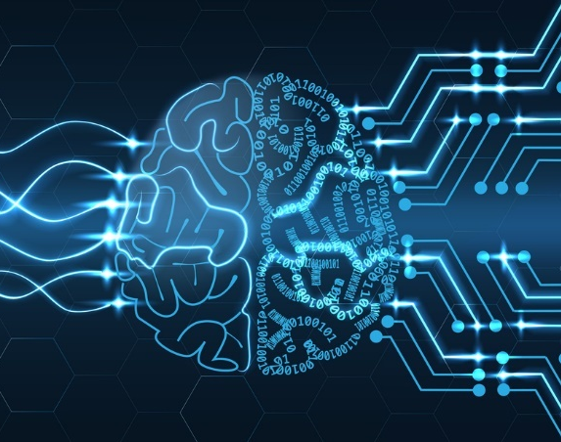

Bengali Number Recognition by
Deep Learning
NAME: Amit Kishor Das
ID: 13301096
NAME: Tasnuva Tarannum
Brac university
ID:14101133
1
WORK PROCESS
FUTURE WORK
REFERENCES
Home
INTRODUCTION
USAGE OF DEEP LEARNING
PROPOSED MODEL
IMPLEMENTATION
RESULT
Thanks
Any question

Slide 2
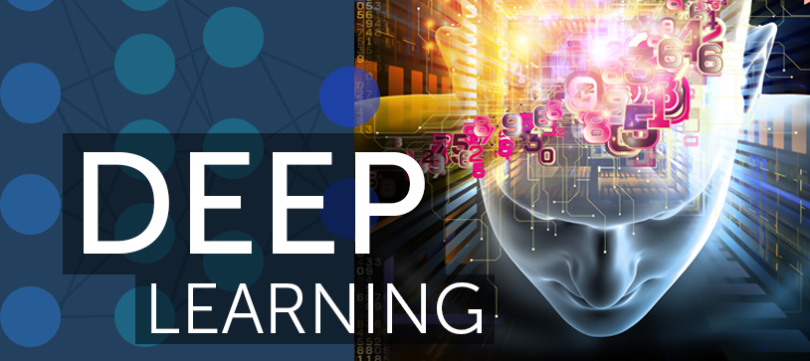
About our Topic
Complete Supervised Learning
classification
Image processing
Machine learning
2
WORK PROCESS
FUTURE WORK
REFERENCES
Home
INTRODUCTION
USAGE OF DEEP LEARNING
PROPOSED MODEL
IMPLEMENTATION
RESULT
Thanks
Any question

Slide 3
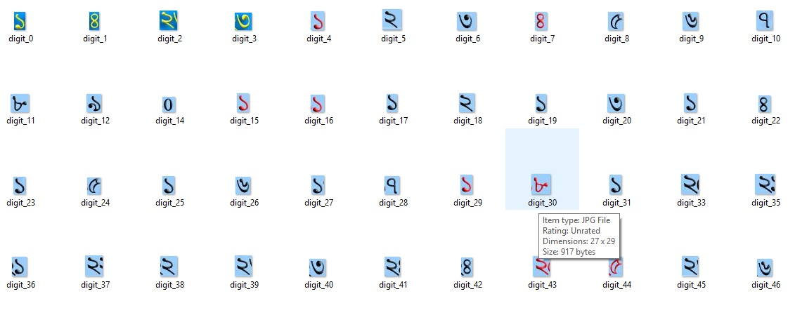
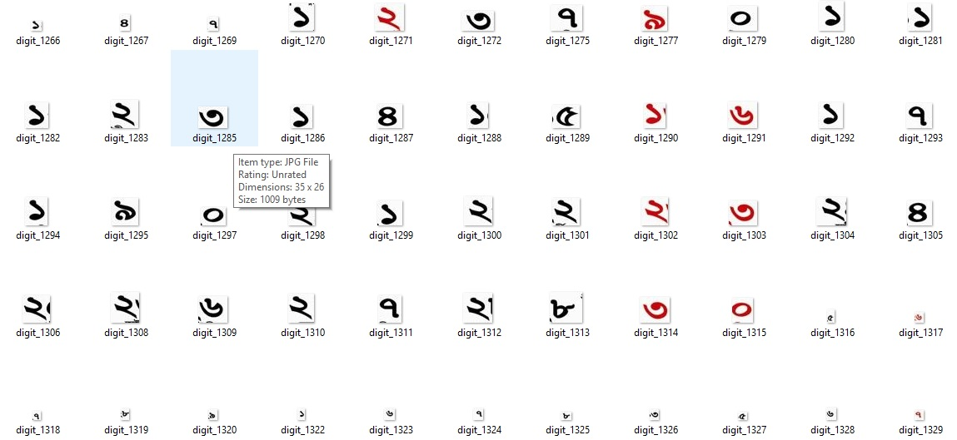
dataset
Total images of 1547.
Started from 0 to 9.
About 80% images are taken for Training Set.
20% images are taken for Test set.
Figure 1: Training and Test set.
3
WORK PROCESS
FUTURE WORK
REFERENCES
Home
INTRODUCTION
USAGE OF DEEP LEARNING
PROPOSED MODEL
IMPLEMENTATION
RESULT
Thanks
Any question

Slide 4
About project
Why Deep Learning?
A system for image recognition.
Convolutional Neural Network.
Convolution.
Flattening.
Max Pooling.
Fully Connected Layer.
We used:
Theano
Tensorflow
Keras
OpenCV
about project
4
WORK PROCESS
FUTURE WORK
REFERENCES
Home
INTRODUCTION
USAGE OF DEEP LEARNING
PROPOSED MODEL
IMPLEMENTATION
RESULT
Thanks
Any question

Slide 5
Work Process
Convolutional Neural Network
Convolution
Create Vector Features.
Max Pooling
Take the Most Prominent Features from Convolution.
Flattening
Create 1D Array of Dominant Features.
Fully Connected Layer
Use ANN Technique to Predict the Object.
Figure 2: Steps of Convolutional Neural Network
5
WORK PROCESS
FUTURE WORK
REFERENCES
Home
INTRODUCTION
USAGE OF DEEP LEARNING
PROPOSED MODEL
IMPLEMENTATION
RESULT
Thanks
Any question

Slide 6
Work Process (continue)
Step 1: Convolution
Figure 3: Animated Figure of Convolution Procedure.
6
WORK PROCESS
FUTURE WORK
REFERENCES
Home
INTRODUCTION
USAGE OF DEEP LEARNING
PROPOSED MODEL
IMPLEMENTATION
RESULT
Thanks
Any question

Slide 7
Work Process (continue)
Step 2: Max Pooling
Figure 4: Animated Figure of Max Pooling Procedure.
7
WORK PROCESS
FUTURE WORK
REFERENCES
Home
INTRODUCTION
USAGE OF DEEP LEARNING
PROPOSED MODEL
IMPLEMENTATION
RESULT
Thanks
Any question

Slide 8
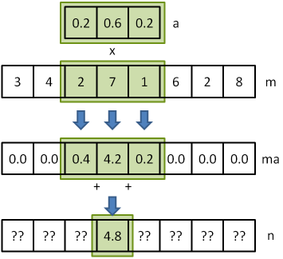
Work Process (continue)
Step 3: Flattening
Figure 5: Figure of Flattening Procedure.
8
WORK PROCESS
FUTURE WORK
REFERENCES
Home
INTRODUCTION
USAGE OF DEEP LEARNING
PROPOSED MODEL
IMPLEMENTATION
RESULT
Thanks
Any question

Slide 9
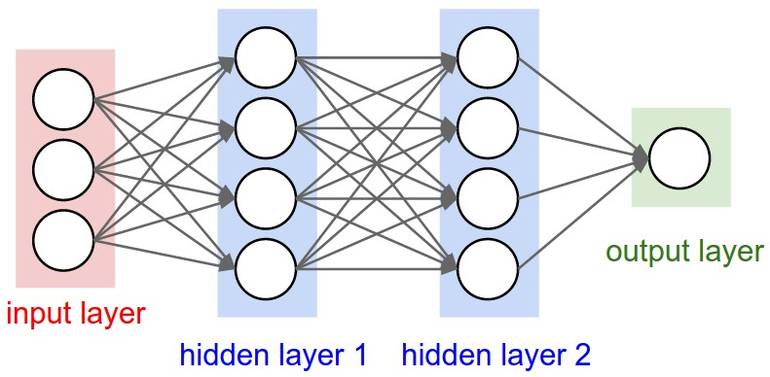
Work Process (continue)
Step 4: Fully Connected Layer
Figure 6: Figure of Fully Connected Layer.
9
WORK PROCESS
FUTURE WORK
REFERENCES
Home
INTRODUCTION
USAGE OF DEEP LEARNING
PROPOSED MODEL
IMPLEMENTATION
RESULT
Thanks
Any question

Slide 10
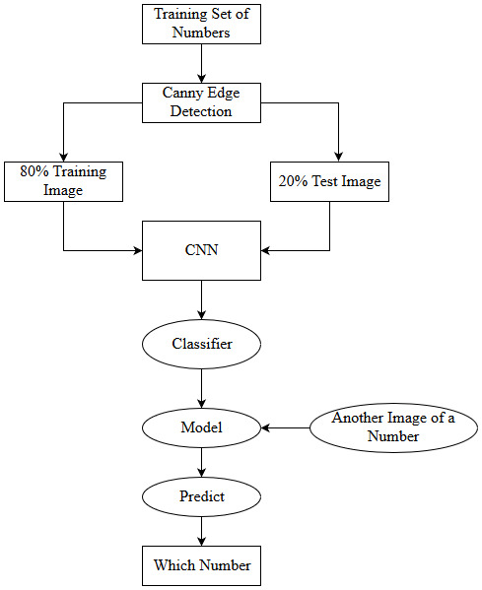
Proposed Model
Detect Canny Age of every Image in the Training Set
Training CNN model as per CNN convention.
80% dataset for Training set and 20% dataset for Test set.
Creating CNN Classifier Model.
Input unique image to recognize the digit.
Predict the as output.
Figure 7: Proposed Model of Number Recognition.
10
WORK PROCESS
FUTURE WORK
REFERENCES
Home
INTRODUCTION
USAGE OF DEEP LEARNING
PROPOSED MODEL
IMPLEMENTATION
RESULT
Thanks
Any question

Slide 11
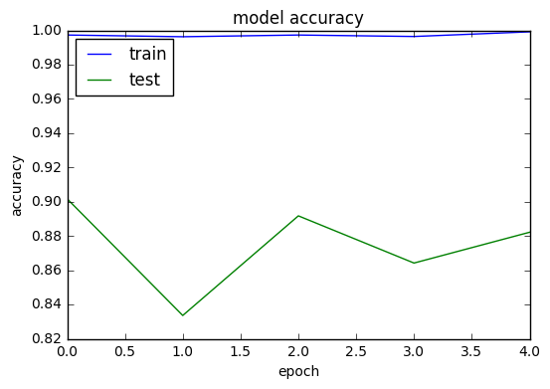
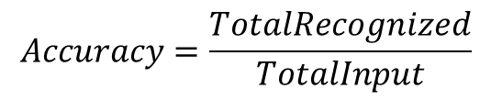
Result
Model Accuracy
Has provided 84% accuracy.
Formula of total accuracy-
$$Accuracy=\frac{TotalRecognized}{TotalInput}$$
Figure 8: Graph of Model’s Accuracy.
20
WORK PROCESS
FUTURE WORK
REFERENCES
Home
INTRODUCTION
USAGE OF DEEP LEARNING
PROPOSED MODEL
IMPLEMENTATION
RESULT
Thanks
Any question

Slide 12
Result(Continue)
Model Accuracy
Has given 80% or more accuracy for each test set after implementing CNN model with Canny Edge Detection.
Providing 83% exactness of our model work by averaging all the accuracy.
Round | Number of Image | Detection |  | Accuracy of True Detection | Average Accuracy
 |  | True | False
1 | 20 | 16 | 4 | 80% | 83%
2 | 35 | 30 | 5 | 85%
3 | 50 | 42 | 8 | 84%
Table 1: Accuracy of True Detection.
21
WORK PROCESS
FUTURE WORK
REFERENCES
Home
INTRODUCTION
USAGE OF DEEP LEARNING
PROPOSED MODEL
IMPLEMENTATION
RESULT
Thanks
Any question

Slide 13
conclusion
Publication target:
Yes, in future
A better knowledge about :
Image processing and machine learning
11
WORK PROCESS
FUTURE WORK
REFERENCES
Home
INTRODUCTION
USAGE OF DEEP LEARNING
PROPOSED MODEL
IMPLEMENTATION
RESULT
Thanks
Any question

Slide 14
references
1. Where did you get the idea (journal, conference, website)
2. Dataset:
https://www.kaggle.com/debdoot/bdrw/data
3. Basic code: https://www.udemy.com/machinelearning/learn/v4/content
4.Tutorial we are following :
Machine Learning A-Z™: Hands-On Python & R In Data Science
12
WORK PROCESS
FUTURE WORK
REFERENCES
Home
INTRODUCTION
USAGE OF DEEP LEARNING
PROPOSED MODEL
IMPLEMENTATION
RESULT
Thanks
Any question

Slide 15
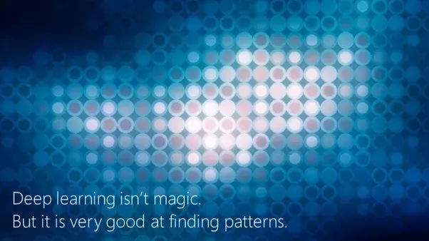
THANK YOU
13
WORK PROCESS
FUTURE WORK
REFERENCES
Home
INTRODUCTION
USAGE OF DEEP LEARNING
PROPOSED MODEL
IMPLEMENTATION
RESULT
Thanks
Any question

Slide 16

Any Question
14
WORK PROCESS
FUTURE WORK
REFERENCES
Home
INTRODUCTION
USAGE OF DEEP LEARNING
PROPOSED MODEL
IMPLEMENTATION
RESULT
Thanks
Any question

